Slide 1






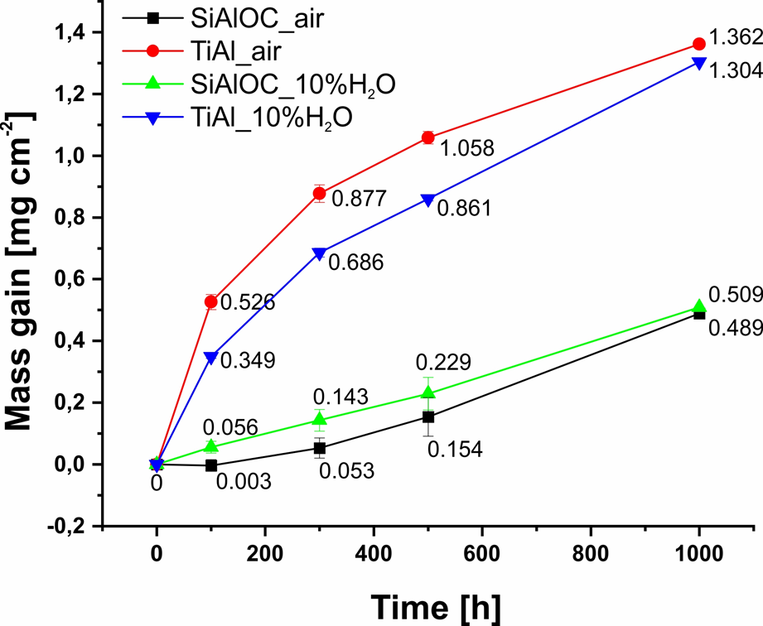
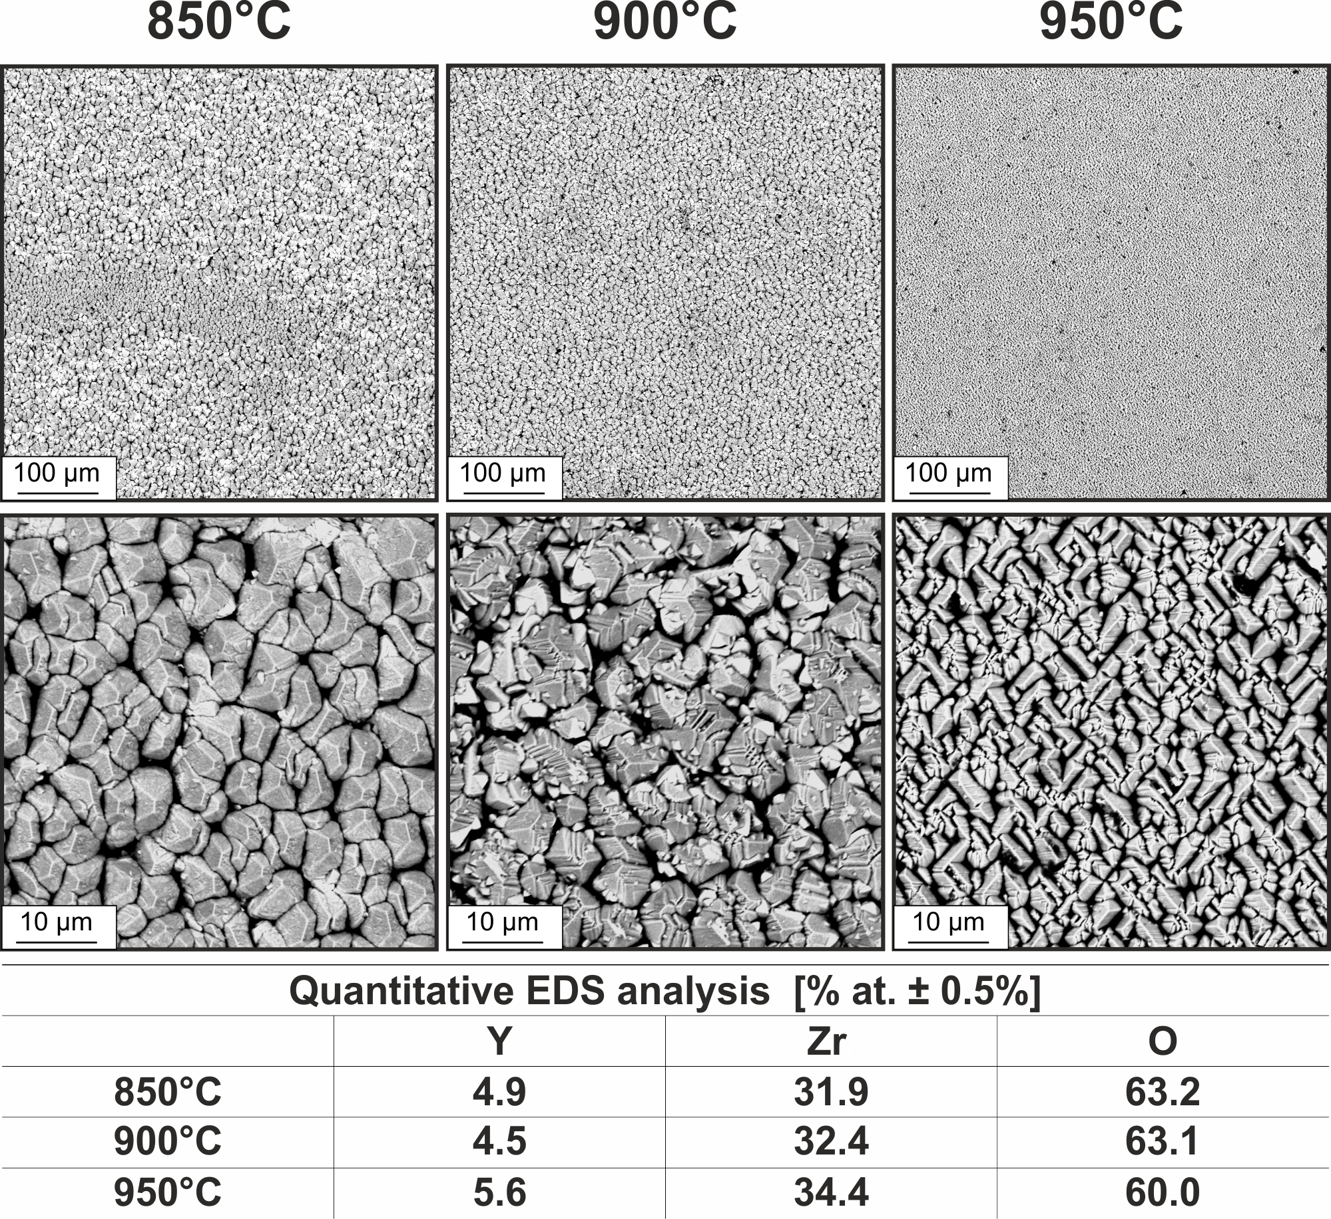
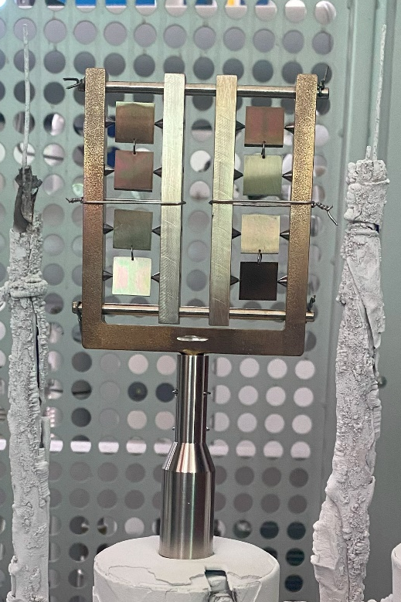
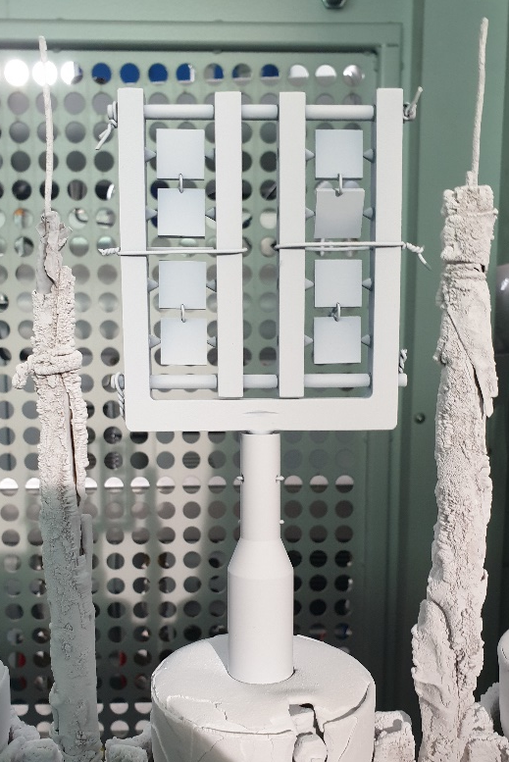
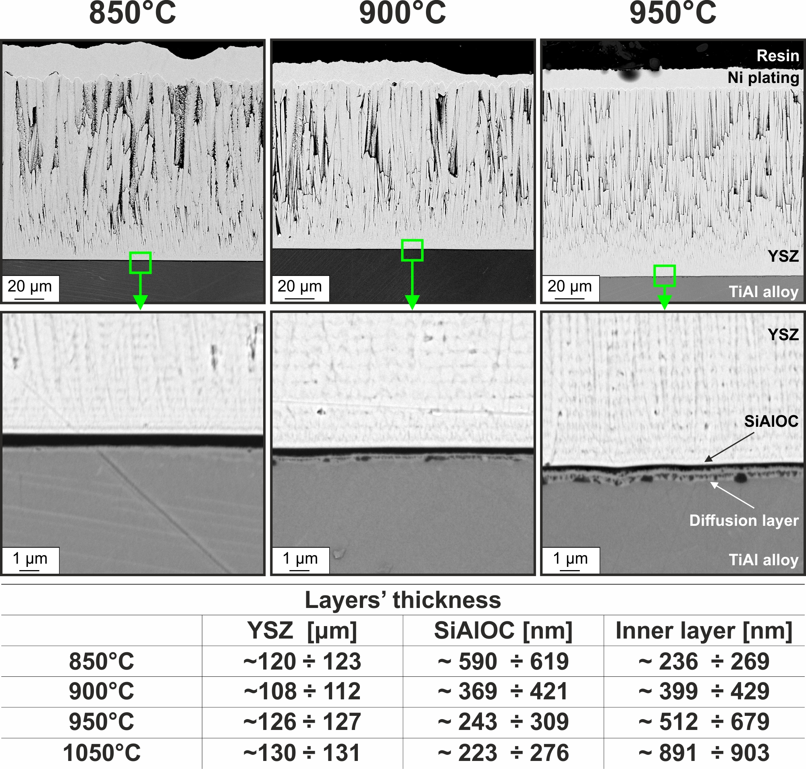
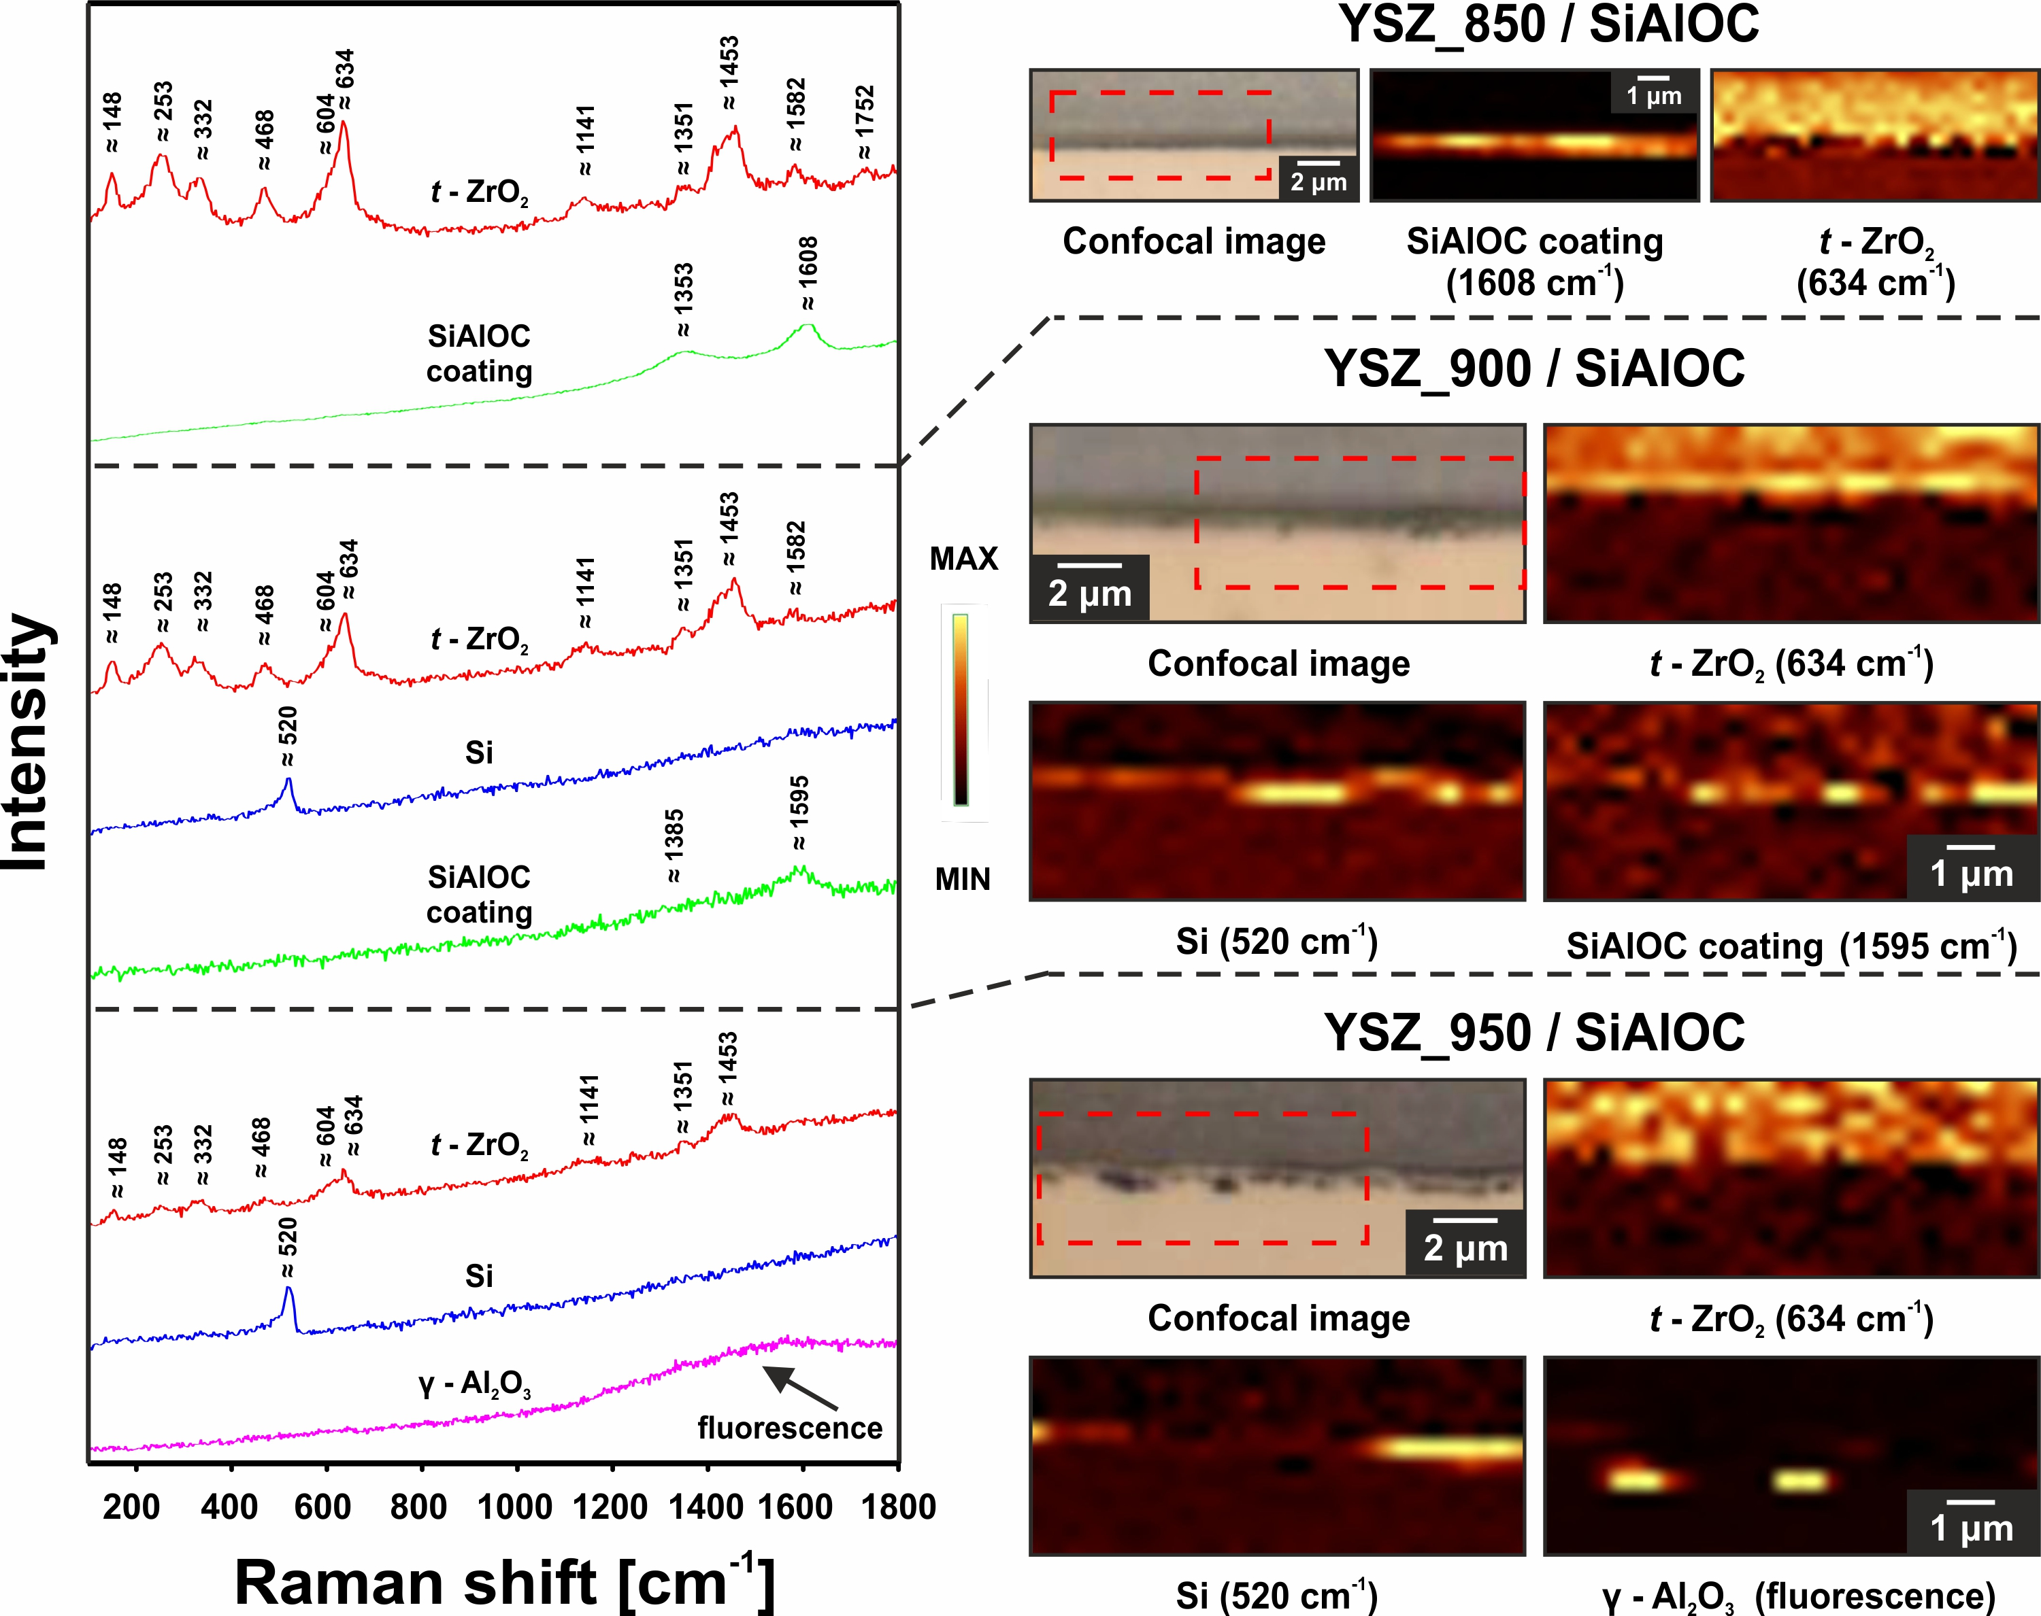
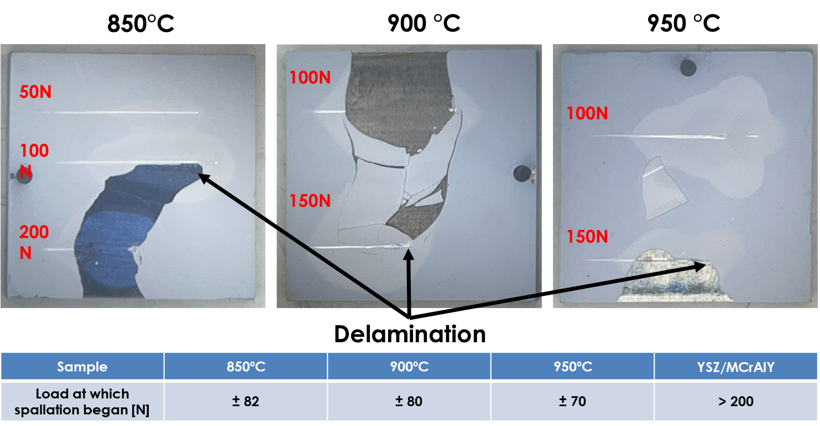
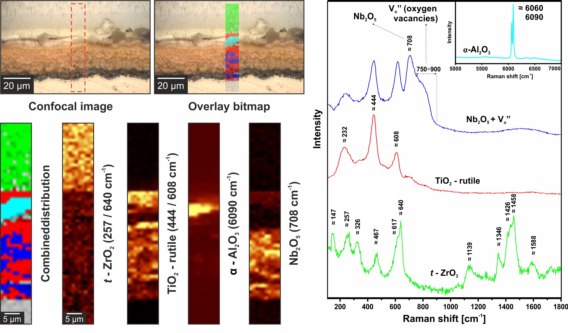
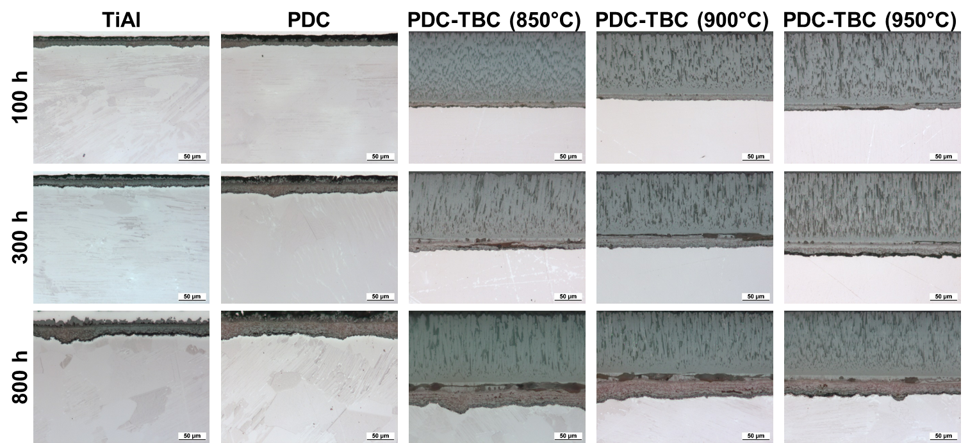
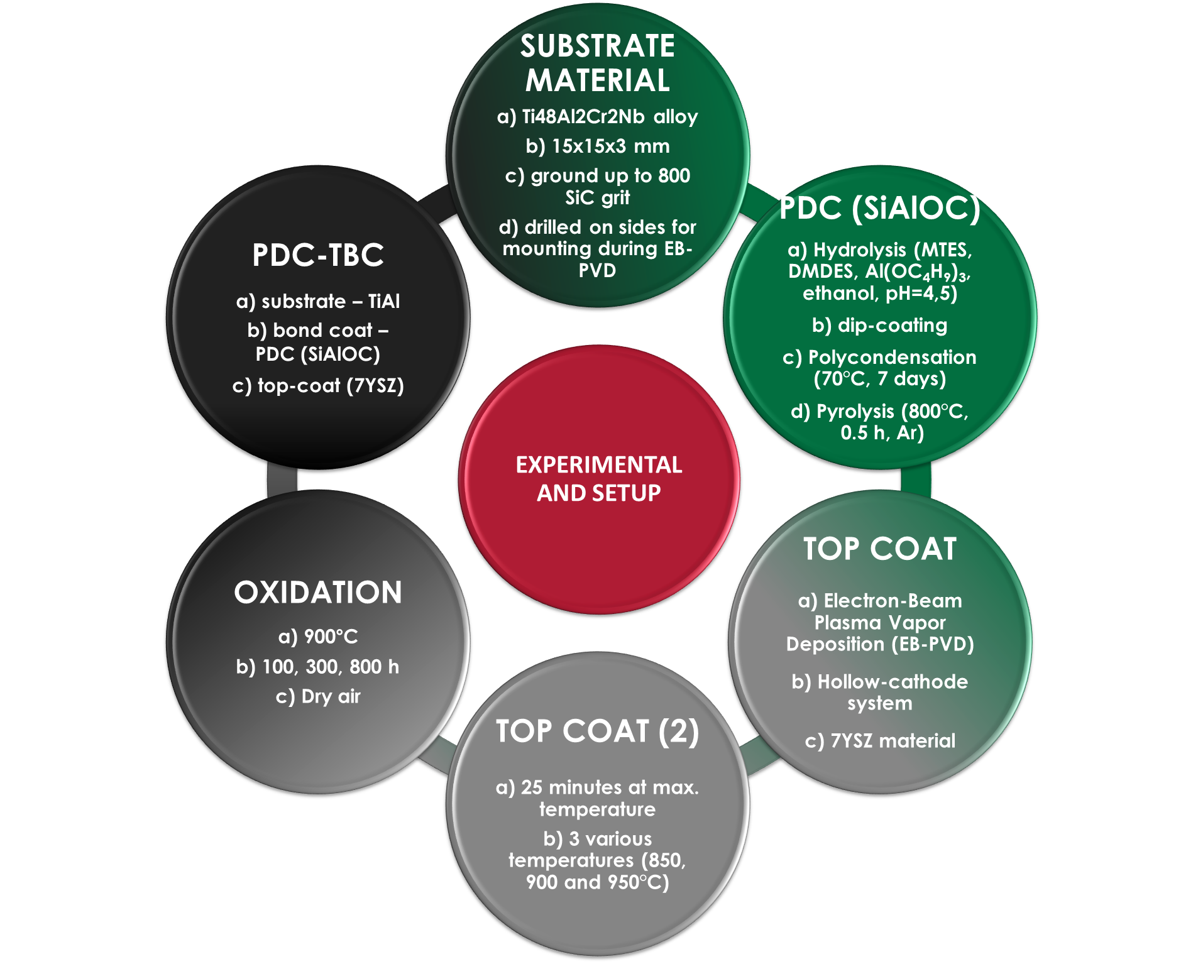
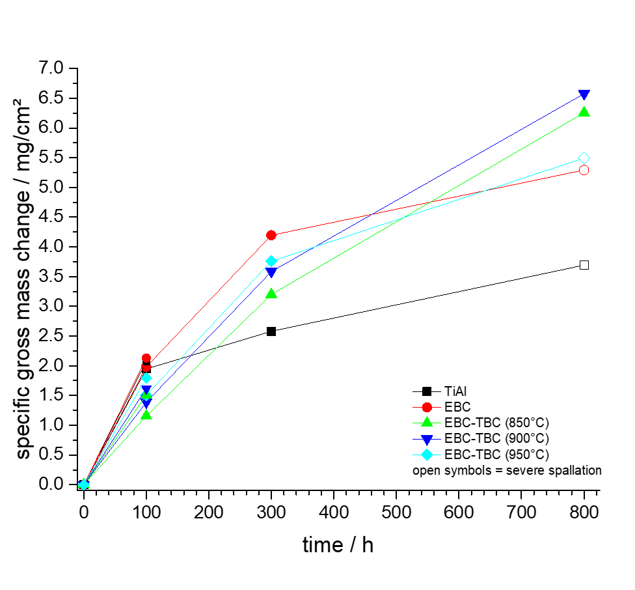




New Thermal Barrier Coatings with Polymer Derived Ceramic Bond Coats for TiAl alloys
G. Ryczek^{1*}, M. Bik², M. Sitarz², A. Nowotnik³, G. Maciaszek³, K. Cioch³, D. Nabel³, C. Schlereth⁴, E. White⁴, M. Galetz⁴
- Silesian Aviation Cluster, Kaniów, Poland
- Faculty of Materials Science and Ceramics, AGH University of Krakow, Poland,
- Department of Material Science, Research and Development Laboratory for Aerospace Materials, Rzeszow University of Technology, Rzeszów, Poland
- DECHEMA-Forschungsinstitut, Frankfurt am Main, Germany
(* Presenting author - gabriela.ryczek@aerosilesia.eu)
OBJECTIVES
Motivation
• To investigate structure, microstructure, adhesion and oxidation resistance of first-ever Thermal Barrier Coatings with Polymer Derived Ceramic bond coats for TiAl alloys
• Optimisation of EB-PVD processing parameters for a new coating system
• Application of Raman imaging as an efficient tool for evaluating Thermal Barrier Coatings
Replacement of Ni-based alloys with TiAl alloys
Solving the problems with conventional bond coats on γ-TiAl (brittle phases, interdiffusion, low oxidation resistance)
High potential of Polymer Derived Ceramics coatings on γ-TiAl for oxidation resistance
1
Results
2
Fig. 1. Oxidation kinetics of uncoated and PDC (SiAlOC)-coated 48-2-2 TiAl alloy in dry and humid air [1].
Fig. 2. Holder with attached model samples: after coating with PDCs, (left), after the EB-PVD process at 850°C (right).
3
4
5
Fig. 3. Surface microstructure of PDC-TBC coatings after EB-PVD process with EDS analysis.
Materials &
Methods
•SCANNING ELECTRON MICROSCOPY (SEM) – Phenom XL (10 kV)
• ELECTRON DISPERSIVE SPECTROSCOPY (EDS) – Phenom XL (Phenom Prosuite)
(15 kV) • RAMAN SPECTROSCOPY – WITec alpha 300M+ (488/633 nm
Lasers, 600 gratings) • ADHESION (NANOINTENDATION)
STUDIES - CSM-Revetester (up to 200 N)
Fig. 4. Cross-sectional microstructure of PDC-TBC coatings after EB-PVD process with layers’ thickness estimation.
Fig. 5. Raman imaging of PDC-TBC coatings after EB-PVD process.
7
Fig. 6. Adhesion of PDC-TBC coatings after EB-PVD process (optical images after nanointendation studies).
8
Fig. 8. Raman imaging of PDC-TBC coating produced at 850°C after oxidation studies at 900°C.
Fig. 9. Cross-sectional microstructure (optical images) of PDC-TBC coatings after oxidation studies at 900°C.
References
[1] M. Bik, M. Galetz, L. Mengis, E. White, W. Wieczorek, Ł. Klaudia, K. Mroczka, J. Marchewka, M. Sitarz, Appl. Surf. Sci. 632 (2023) 157601.
6
Fig. 7. Oxidation kinetics of uncoated, PDC-, and PDC-TBC-coated 48-2-2 TiAl alloy in lab air at 900°C.
CONCLUSIONS
The applied approach resulted in the successful formation of Thermal Barrier Coatings with first-ever bond coat based on Polymer Derived Ceramics
The application of hollow-cathode system provided an unique chance to significanlty lower the EB-PVD processing temperature (ca. 200°C comparing to standard procedures) thanks to the higher plasma current. Because of this, both alloy and bond coat were not exposed to too high temperatures during TBC formation
Both cross-sectional analysis and adhesion studies, revealed that produced TBCs have a good adhesion, but significanlty lower than conventional YSZ/MCrAlY systems
Structural and microstructural studies revealed that with increasing processing temperature of EB-PVD (900 and 950 °C), both alloy and bond coat were starting to degrade (non-continous alumina was formed, and PDC-SiAlOC bond coat was decomposed to elemental Si – the lowest temperature (850 °C) resulted in the most optimal microstructure)
Oxidation studies and post-mortem characterization revelead that current approach is not satisfactory, as all tested samples were severely degraded after 800 h of oxidation at 900 °C. In future works, EB-PVD processing temperature will be even lowered to provide more resistant coatings.
Acknowledgements
This research was financed within the framework of project Novel Thermal Barrier Coatings with Polymer-Derived Ceramic interlayers for jet engine critical components (PDC-TBC)co-funded by NCBR (Poland) and IGF (Germany) within the framework of the CORNET (Collective Research NETworking) 35th innitative.

